Slide 1
Word Sentiment Analyzer
Using a Raspberry Pi

Slide 2
Contents
What is it? & Use Cases
Components
Flow Chart
Circuit Diagram
Physical Connection
Run Procedure
Logic

Slide 3
What is it? & Use Cases
This project is to analyze the sentiment associated with a word that is entered by a user
Most text analysis use the concept of tagging associated with words
This uses a similar concept where words of the English language are classified and kept in separate databases
When a word needs to be analyzed, it is compared against these DB and a result is presented
At present it provides only 3 classifications – positive, negative and neutral words
It can be extrapolated for sentiments such as anger, joy, sad, etc. and refine the analysis.

Slide 4
Components (Hardware and Software)
Raspberry Pi 3b
LED
Resistors
Bread Board
Power Supply
WiFi (Wirelessly Connect Pi to MacBook)
Terminal to connect (ssh) to Pi and navigate, store, and programs on the Raspbian OS
Python Program

Slide 5
Flow Chart
Start
Input from user (word to analyze)
Code associated with the
Project can be found here
Perform the comparison against the database of positive, negative words
Is in
+ve DB?
No
If in
-ve DB
No
Yes
Yes
Yes
Print result on screen as Positive Word, light up Green LED
Print result on screen as Negative Word, light up Red LED
Print result on screen as Neutral Word, light up Yellow LED
Do you want to continue analyzing?
End

Slide 6
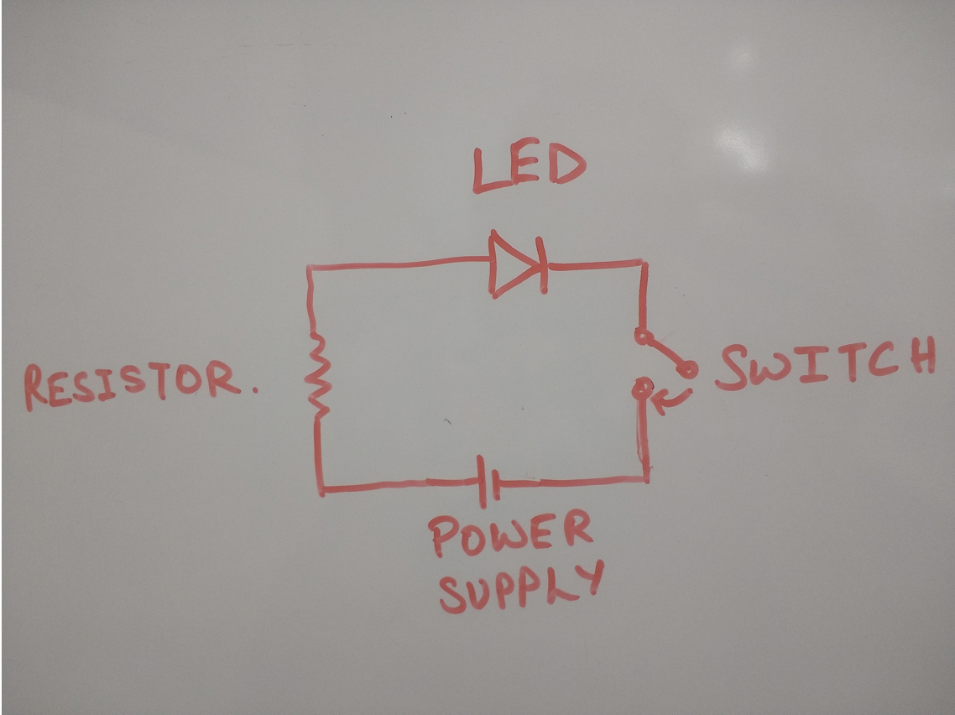
Circuit Diagram
Note: This is the circuit per LED –
Green, Red and Yellow.
Based on the condition that is satisfied
one of these LEDs light up
The switch completes the circuit if the associated condition is satisfied.

Slide 7
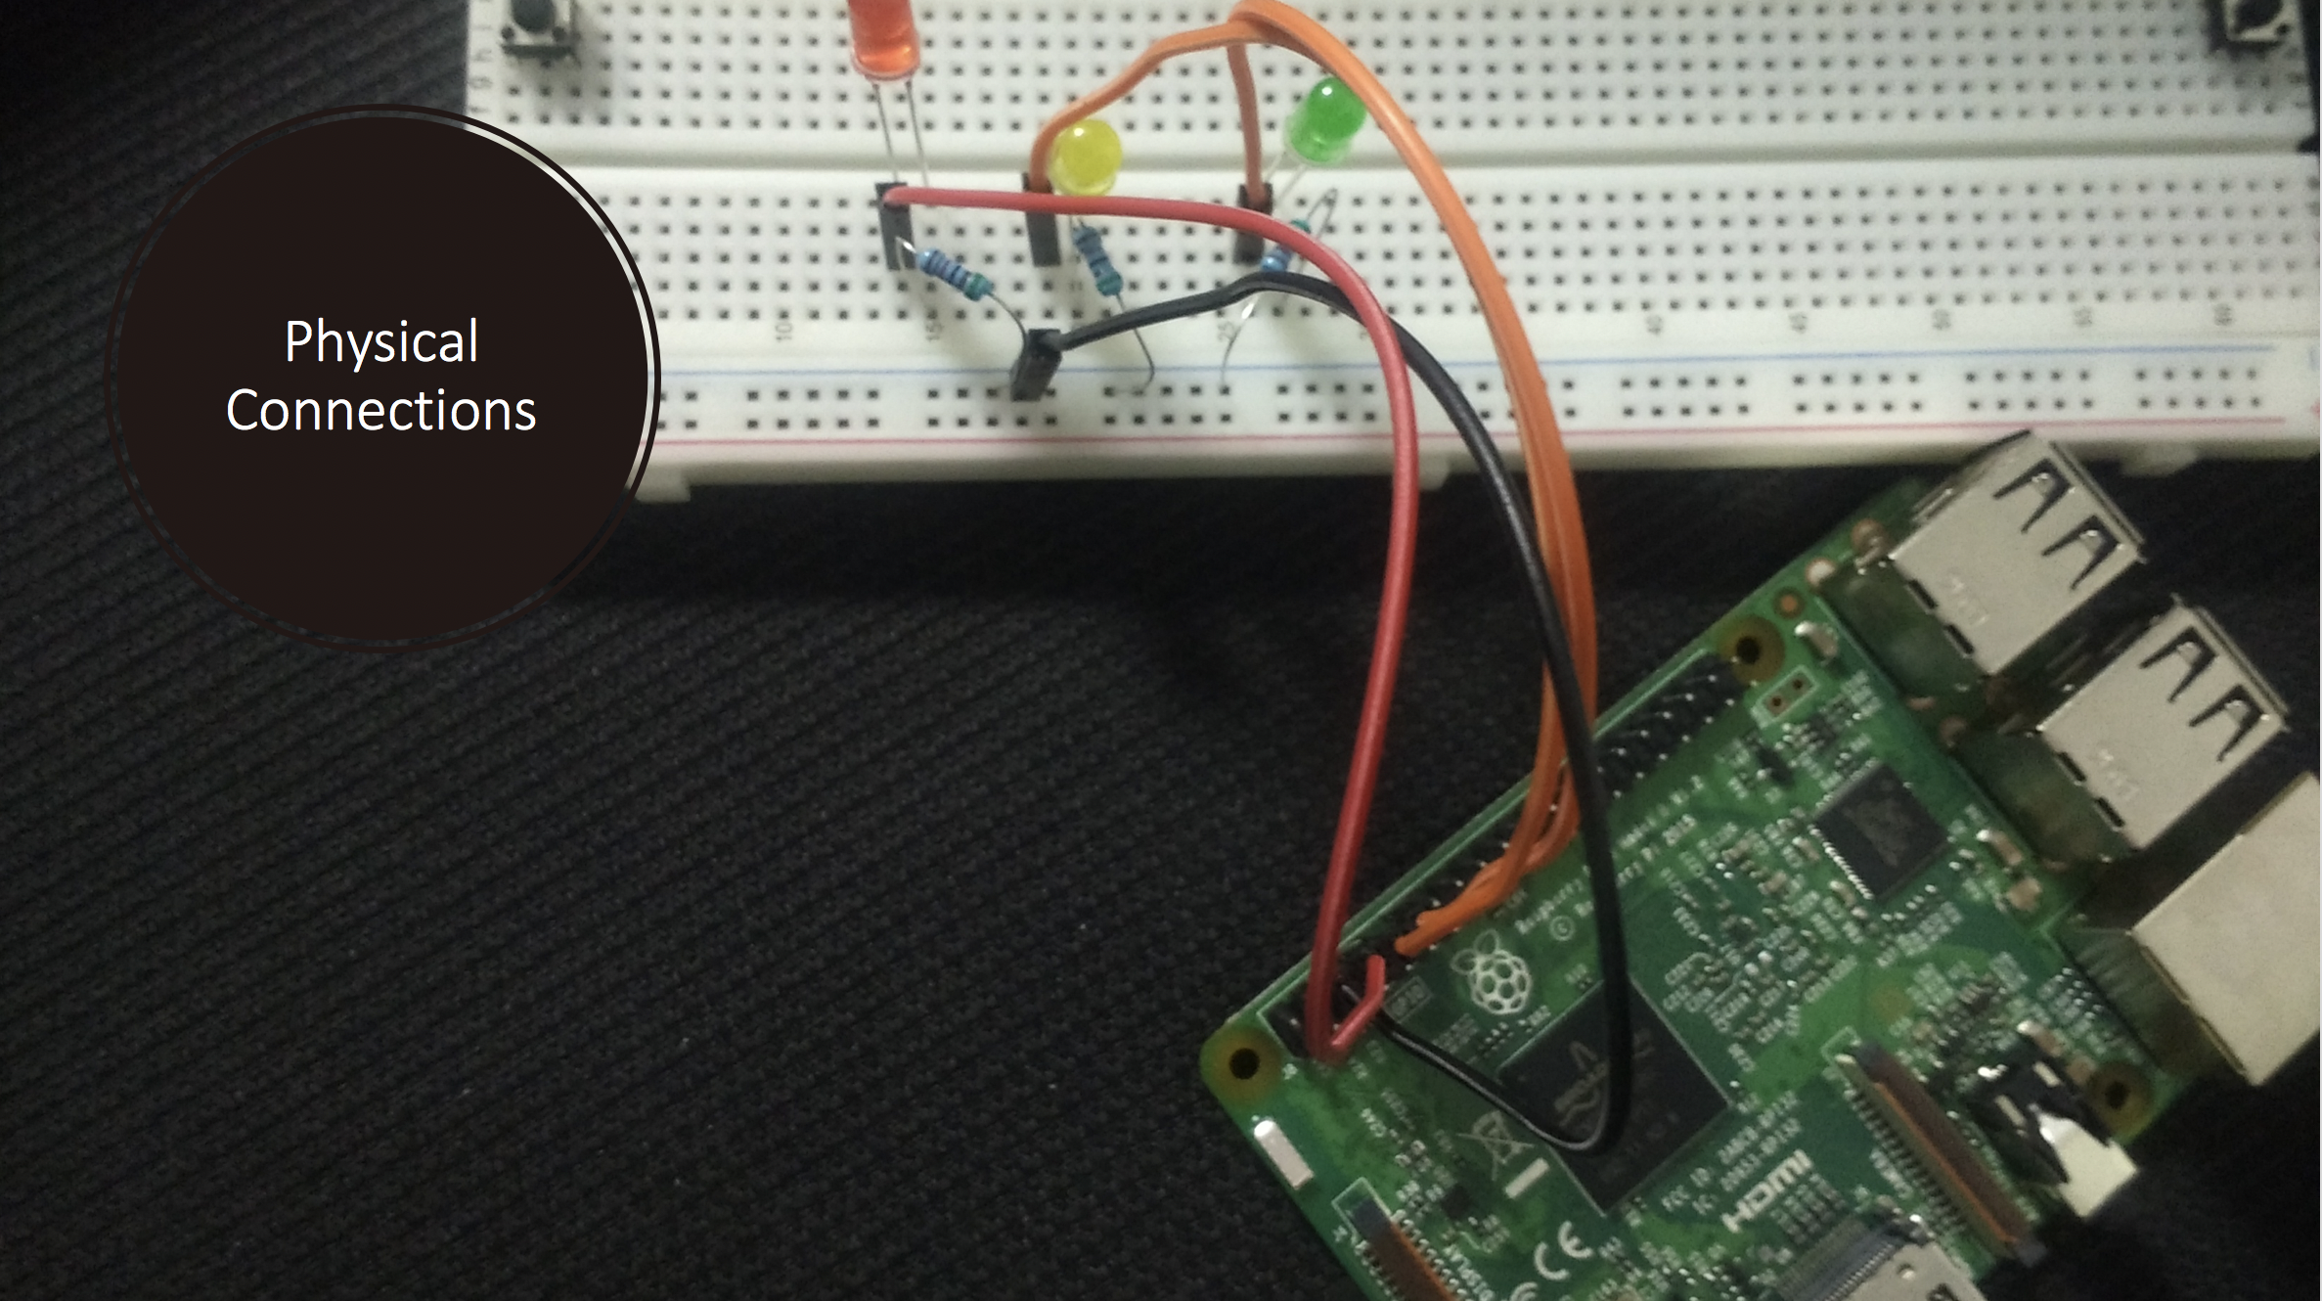
Physical Connections

Slide 8
Run Procedure
The code resides on the Pi. Upon Power up, connect the Pi wirelessly to your network and ssh using the terminal. You can now access the Pi File Server.
Run the program Sentiment_Analyzer.py
Respond to the prompts that appear on the screen
Once you have entered the word, the sentiment associated with it is displayed on the screen along with a glowing LED on the Pi.
If the associated sentiment is +ve -> Green LED, -ve -> Red LED and Neutral -> Yellow LED

Slide 9
Logic
How does it know what the sentiment is?
There are two databases downloaded from Lexicon, one for positive words, one for negative words. These databases are used for several whitepapers and are reliable.
If the word is found in either database, the associated sentiment is displayed
If the word is found in none of the two databases, then the associated sentiment is considered Neutral*
*Hence the assumption here is that the databases are whole and complete for positive and negative sentiments and no word can have more than one sentiment associated with it. This means that all 3 sets, positive, negative and neutral (unclassified words) are mutually exclusive

